Slide 1
Primary
Education

Slide 2
Being a
School Governor
Could you become a governor when you're older?
[Name of School]
Notes:
Slide 1 – Introduction (first)
Hello, my name is xxx and before we begin I wonder whether any of you know who I am or what my role is in xxx school?
Children contribute ideas
That’s right / Well actually I’m one of your school governors and we’re here today to talk to you about what we do and why it’s important.
We’d also like to know it’s something you think you could do when you’re older? Raise your hand if it’s ever crossed your mind...
Children put hands up or not!
If lots put up their hand: Well that’s great to see – I guess you need to know a bit more about what the role involves!
If few put up their hand: Well, let’s see if we can change your mind!
We’re going to share lots of information today – and there will be a short quiz at the end so make sure you’re listening carefully.

Slide 3
Community
Definition:​
A group of people with something in common​
2
Notes:
Slide 2 - Community
Before we begin, I’d like to know what you think the word Community means?
Children contribute ideas
What great ideas you have – if we looked it up in the dictionary it would say that a community is a group of people with something in common. So if we think about our school community here we have --- school in common

Slide 4
Who makes up our community?
School staff
Visitors
PTFA
Children
Parents and Carers
Our neighbours
Governors
3
Notes:
Slide 3 – What makes up a community?/BHO
So who do you think makes up our community – who are the people who have xxx school in common?
Children contribute ideas
Here are some suggestions – did we get them all? Were there any that I hadn’t thought of?
All of these people have different backgrounds, different experiences and difference ideas, but they all make up our community.
One of the groups in our community are the school governors – that’s us. We’re coming into speak to you today because our role is a volunteer role. Does anyone know what a volunteer is?
Children contribute ideas
Great – a volunteer is a person who does something, especially helping other people, willingly and without being forced or paid to do it. Lots of people we rely on are volunteers:
In school: people who come in and hear you read, people who help out on school trips
Outside school – people who run brownies and cubs. Add other examples that fit your school demographic.
To mark His Majesty The King’s Coronation, thousands of organisations across the country are getting together to give us all the chance to help out in our own local communities. It’s called the “Big Help Out” and that’s why we are talking to you today.
Do you or anyone in your families volunteer your time to make a difference to our community?
Children contribute ideas

Slide 5
Who are our school governors?
List of school governors for [Name of School]
List of school governors for [Name of School]
Who can be a school governor?
Anyone over 18 years old
If a faith-based school, someone who shares the same beliefs
4
Notes:
Slide 4 – Who are our school governors?
One great way to give back to the community is through governance.
All the governors at our school are volunteers, but who are they? Do you know who we are?
Introduce different governors and their role
Each governor to say why they took on the role
Stress – value to school, why you think it’s important, wellbeing benefits of volunteering, skills development
We are all school governors – who do you think can be a school governor?
Children contribute ideas
Old / Young – anyone over 18
Parent / someone who isn’t a parent / someone with children at another school
A teacher
Basically anyone over 18 can be a governor – so maybe, in 10 – 15 years’ time it will be you!

Slide 6
What do the governors do?
Have meetings
Visit the school
Speak to the teachers
Speak to the parents
Talk with children
?
5
Notes:
Slide 5 – What do the governors do?
What do governors do? Have any of you seen us around school? What do you think governors do?
Children contribute ideas
Share slide of ideas

Slide 7
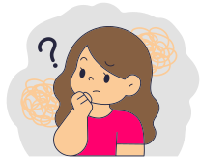
What are governors for?
6
Notes:
Slide 6 – What are governors for?
So that’s what we do, but what are we for? Why do schools need governors?

Slide 8
Some clues for you...
7
Notes:
Slide 7 – Some clues for you
Here are some clues – any guesses?
Children contribute ideas

Slide 9
What are governors for?
Set our vision and ethos – the strategy for the school​
​
What do we want [Name of School] to be like for the pupils and staff?​
​
What do we want to achieve?​
8
Notes:
Slide 8 – What are governors for? (1/3)
Governors have 3 main things that they have to do
They set the vision and ethos of the school – what do we want xxx school to be like? How does it feel going to this school? What do we want to achieve as a community?

Slide 10
What are governors for?
Make sure the money is spent well​
​
What are the most important things to spend our money on?​
​
How can we make sure everyone benefits?​
9
Notes:
Slide 9 – what are governors for? (2/3)
Governors check that the money is well spent. They need to make sure we are spending our money on the right things, that benefit everyone. We don’t want xxx spending it all on chocolate for year 5! What do you think we spend our money on?
Children contribute ideas

Slide 11
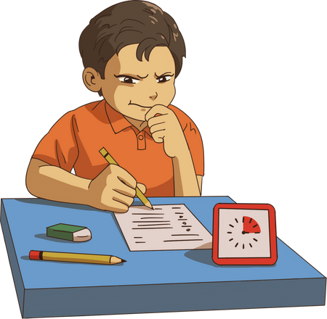
What are governors for?
Educational Outcomes​
Making sure everyone achieves their best, not just in Year 6 but every year​
10
Notes:
Slide 10 – What are governors for? (3/3)
We make sure that your head teacher, xxxx, and the staff here give you a good education, where you achieve your best. We don’t just look at SATs results - we want to know how much progress you are making and whether you are being supported in your learning and planning for the future.
We’ll ask how that’s happening and what the school is doing to make sure.

Slide 12
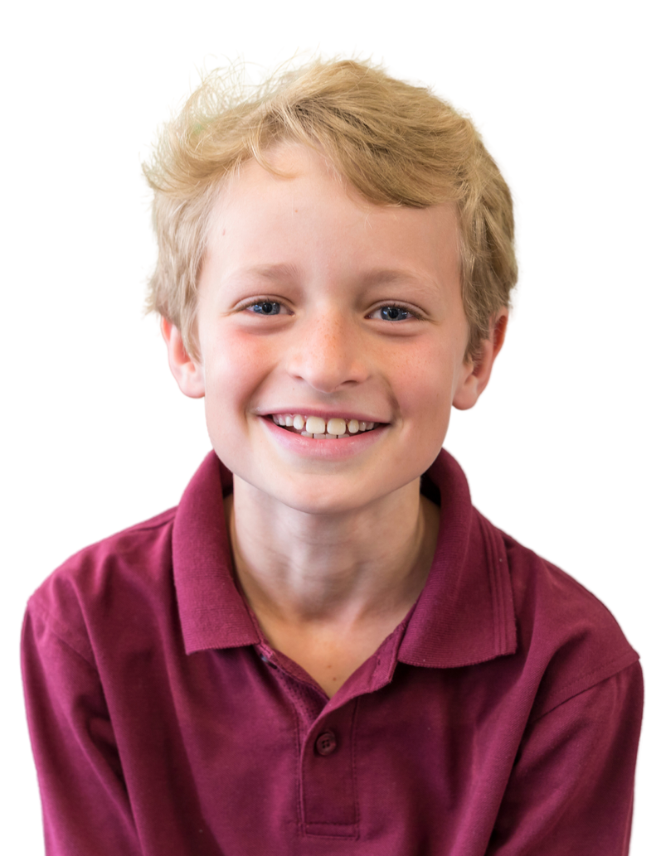
Quiz
What does the word community mean?
Who can become a school governor?
What three things are the school governors responsible for?
Could you become a governor when you're older?
Notes:
Slide 11 – Quiz (last)
Thank you all so much for listening today. We’re going to end up with a quiz to see how well you have been paying attention!
What does the word community mean?
Who can become a school governor?
What three things are the school governors responsible for?
Finally, could you become a governor when you are older? – Hands up
Who else could you tell about being a school governor? Maybe an adult you know would be brilliant!

Slide 13
Templates

Slide 14
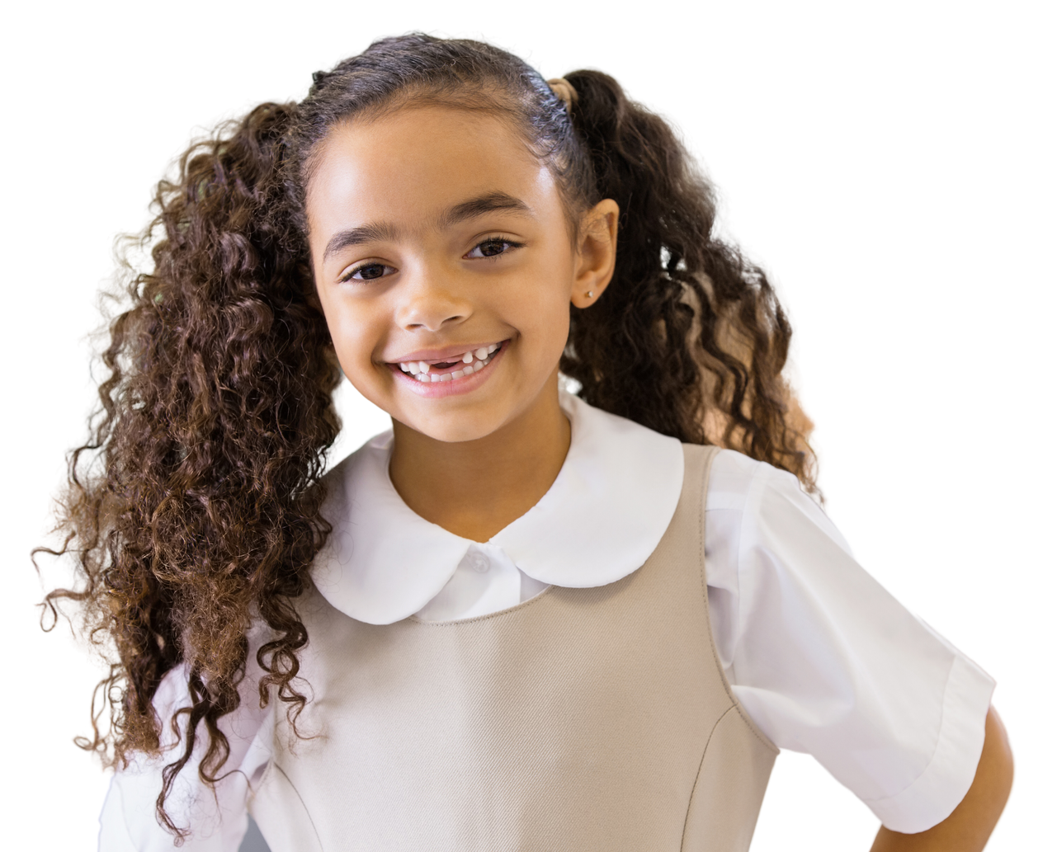
Being a
School Governor
Could you become a governor when you're older?
Name of School

Slide 15
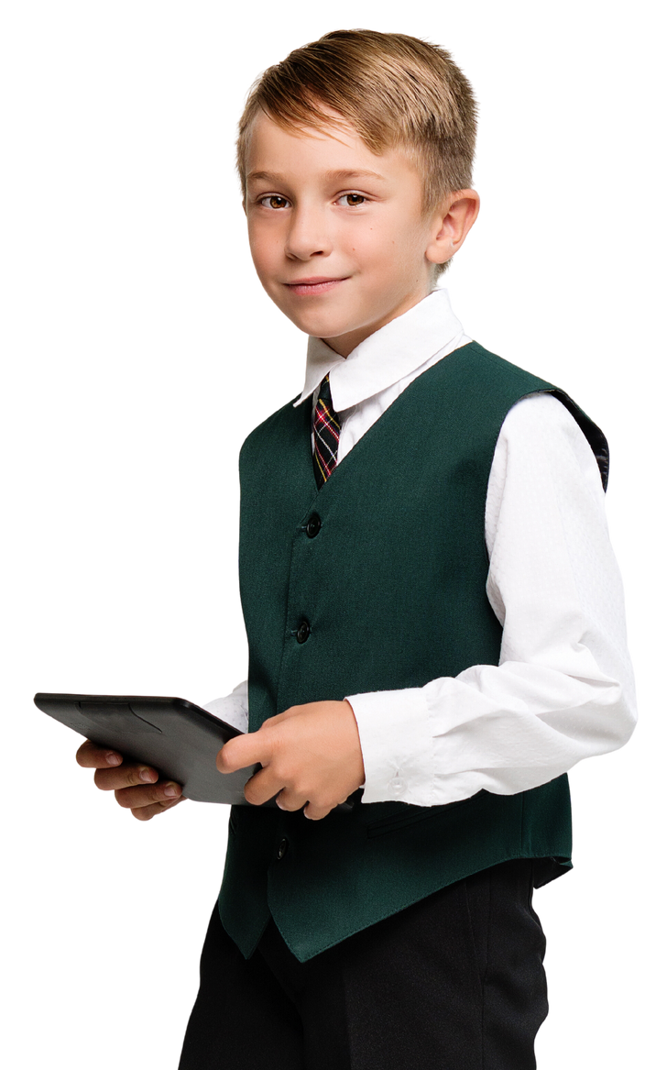
Being a
School Governor
Could you become a governor when you're older?
Name of School

Slide 16
Being a
School Governor
Could you become a governor when you're older?
Name of School

Slide 17
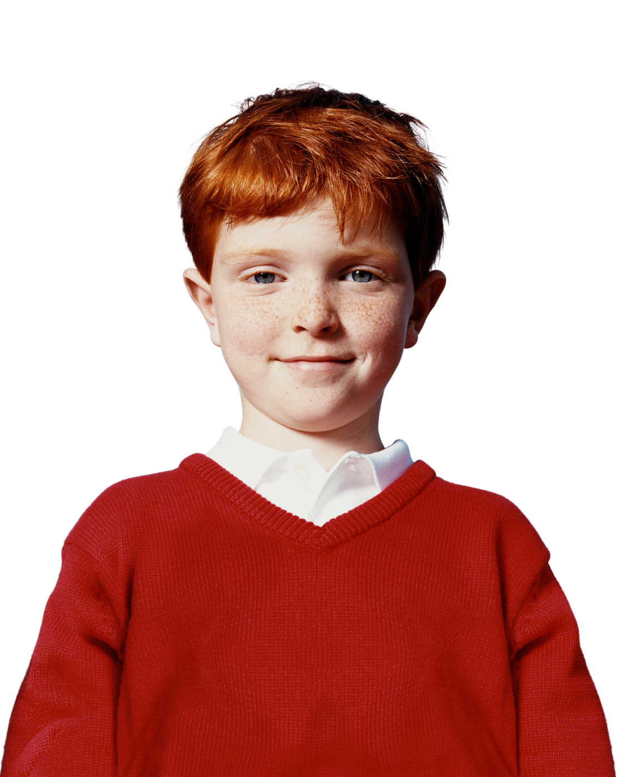
Being a
School Governor
Could you become a governor when you're older?
Name of School

